Slide 1


Digital Portfolio
STUDENT NAME: GOWTHAM.C
REGISTOR NO AND NMID: 222411457 /
CE929B1A62AD445B13E4045E6F8D3
DEPARTMENT: BSC .COMPUTER SCIENCE
COLLEGE/UNIVERSITY: Mangalam College of Arts & Science / University of Madras

Slide 2


Project Title
Interactive digital portfolio using front end development

Slide 3

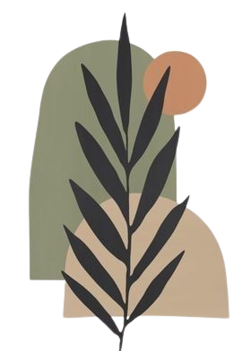
Agenda
Problem Statement
Project Overview
End Users
Tools and Technologies
Portfolio design and Layout
Features and Functionality
Results and Screenshots
Conclusion
Github Link

Slide 4
Problem Statement
Traditional resumes are limited and static, making it hard to convey creativity and real-world skills. A digital portfolio brings interactivity and personalization.

Slide 5
Project Overview
This project involves the development of a modern and responsive digital portfolio designed to help individuals showcase their academic, professional, and technical achievements. The portfolio includes key sections such as "About Me", "Education", "Skills", "Certificates", and a "Contact" for easy communication. The main goal is to provide a personalized online space that highlights the user’s strengths and experiences through an interactive and visually appealing interface.

Slide 6
Who Are The End Users?
•Students (academic projects, resumes).
•Job seekers (to share with recruiters).

Slide 7
Tools and Techniqucs
Html
CSS
JavaScript → Interactivity (mobile navigation menu toggle)
Visual Studio Code

Slide 8
PORTFOLIO DESIGN AND LAYOUT
• Home
• About Me
• Skills
• Projects
• Achievements
• Contact
• Responsive navigation with hamburger menu
•Responsive layout (mobile ,desktop view)

Slide 9
Features and Functionality
• Responsive navigation bar with hamburger menu for mobile view
• Skills section displayed using simple list
•Certificates section displayed in grid format
• Contact details with email,-phone number
• Footer copyright

Slide 10
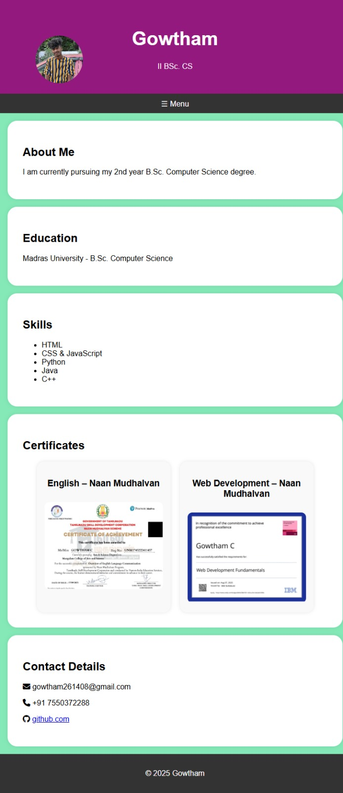
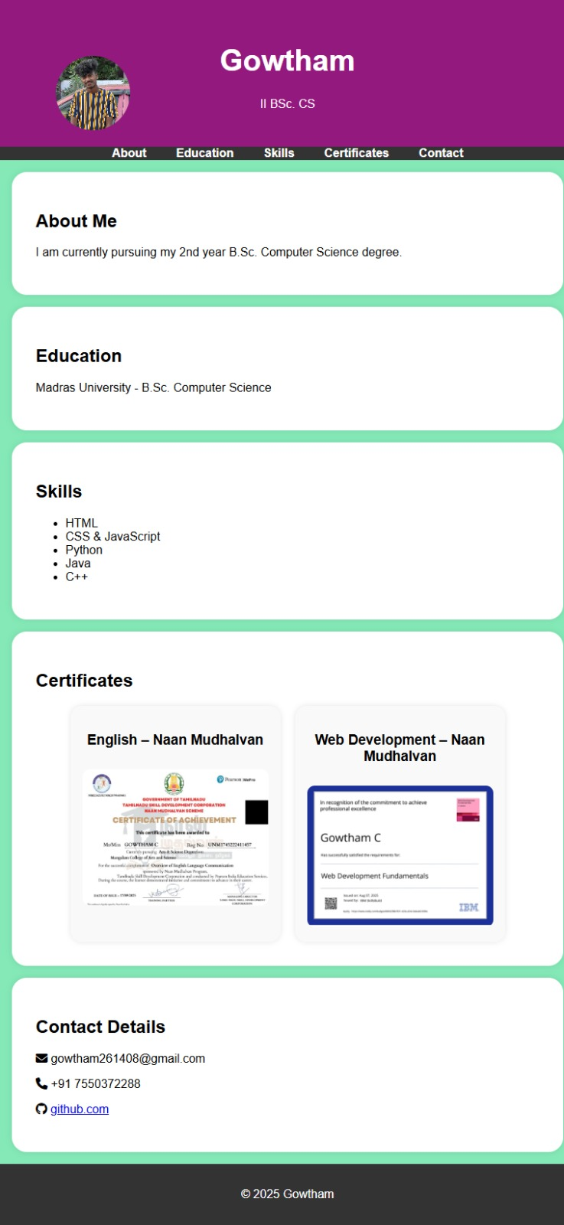
Results And Screenshots
Mobile view
Desktop view

Slide 11
Conclusion
The project demonstrates a personal portfolio with sections like Home, About Me, Skills, Projects, and Contact. Its responsive design and interactive menu ensure smooth navigation. It reflects both creativity and technical growth.
MY Profile : https://gowtham261408-cell.github.io/gowtham1234/

